Slide 1
OpenDSS Training Workshop
Consolidated Edison Co.
New York, NY
Roger C. Dugan
Davis Montenegro
EPRI Knoxville, TN
October 17-18, 2019

Slide 2
Introduction to OpenDSS-G

Slide 3
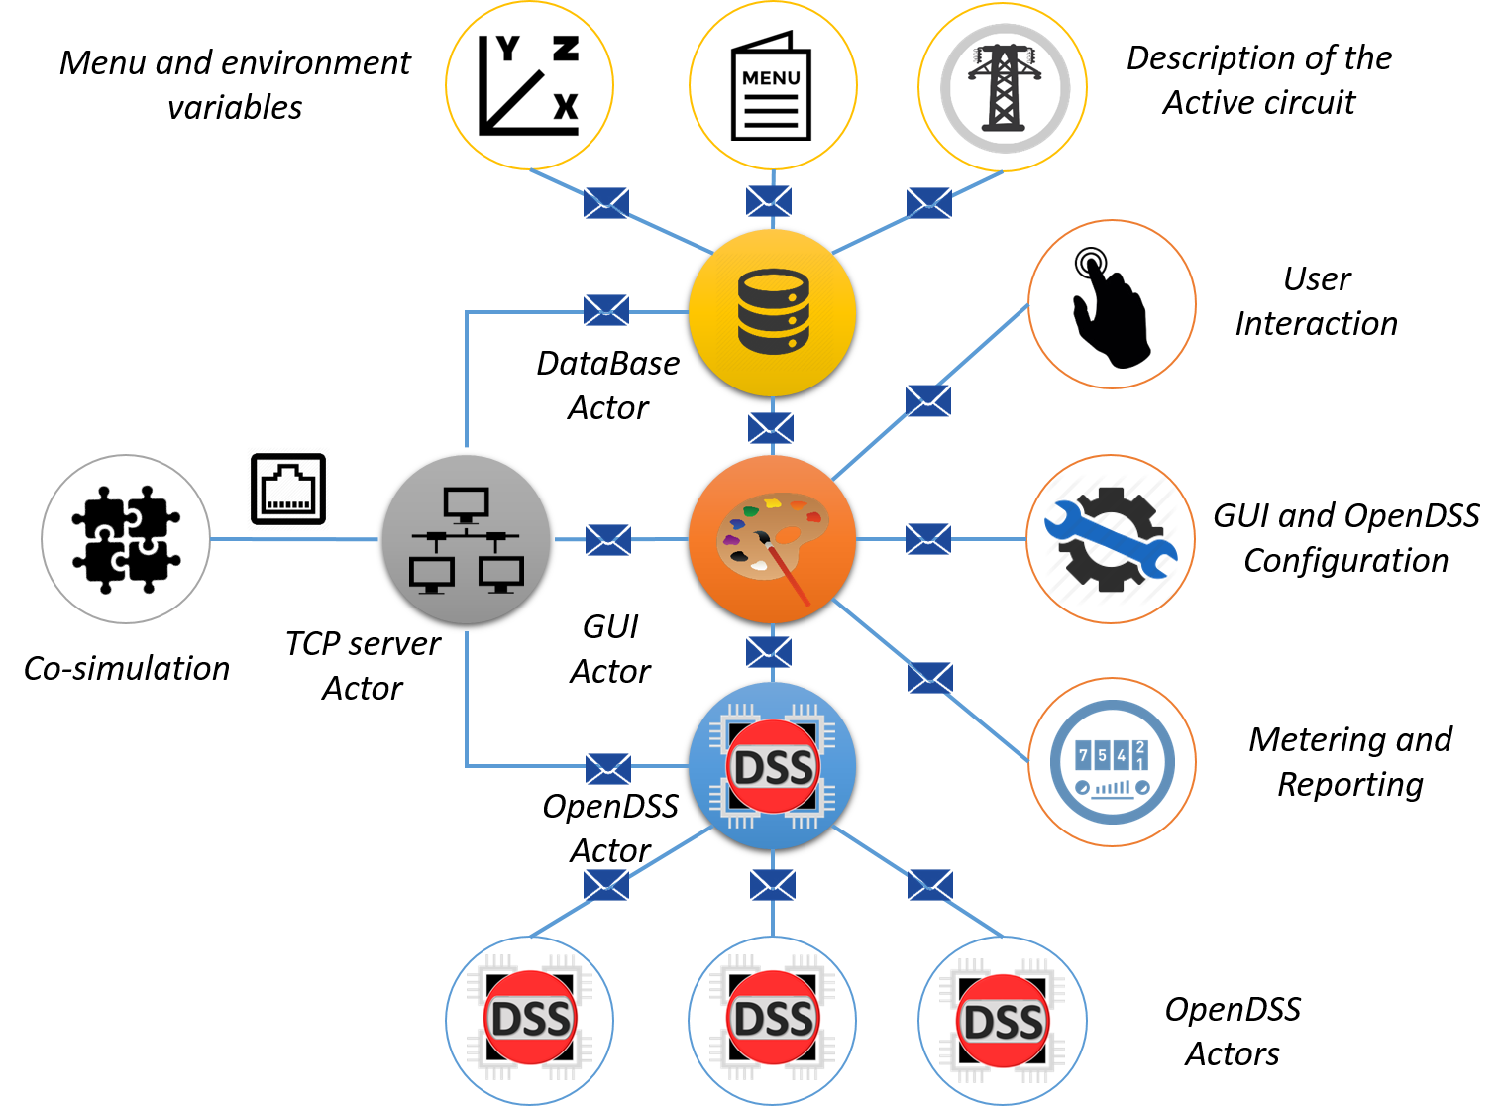
Introduction to OpenDSS-G
OpenDSS-G (formerly DSSim-PC) is a new step in the evolution of simulation tools for planning and operations based in OpenDSS.
This interface has adopted the functionalities of OpenDSS for making easier to the user to use the advance features of the platform.

Slide 4
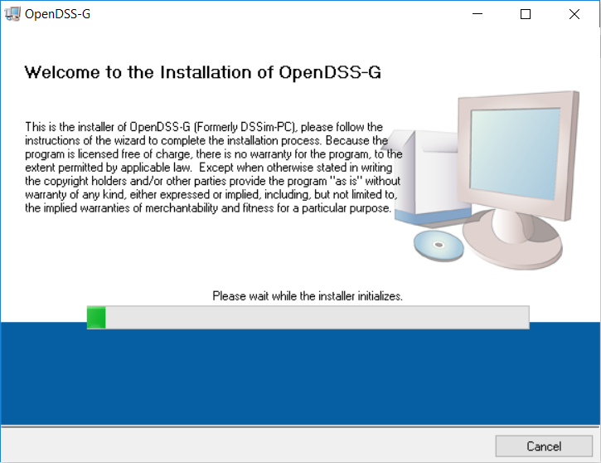
Introduction to OpenDSS-G
Installing OpenDSS-G
Download (https://www.epri.com/#/pages/sa/opendss?lang=es)
Follow the instructions

Slide 5
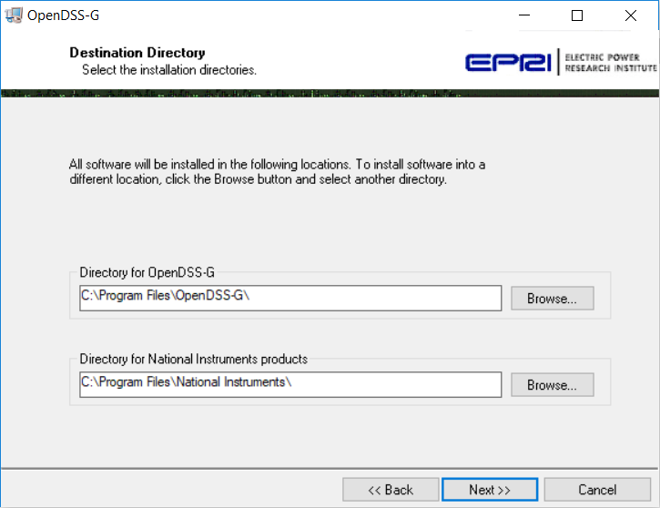
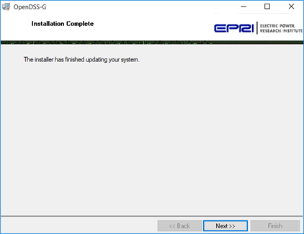
Introduction to OpenDSS-G
Installing OpenDSS-G
Specify the destination folder
Finish

Slide 6
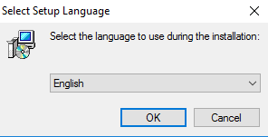
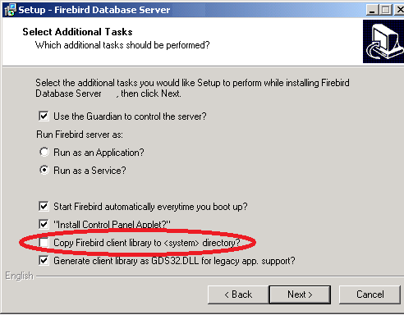
Introduction to OpenDSS-G
Installing OpenDSS-G
Install the database
This is not mandatory but just in case

Slide 7
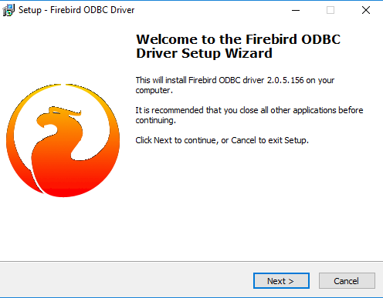
Introduction to OpenDSS-G
Installing OpenDSS-G
Finally, the ODBC
At this point your system should be all set!

Slide 8
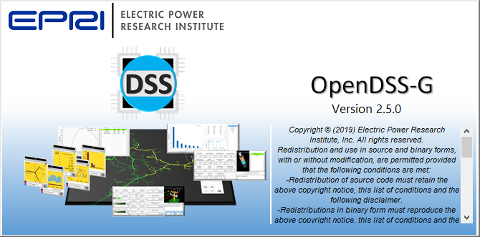
Introduction to OpenDSS-G
OpenDSS-G

Slide 9
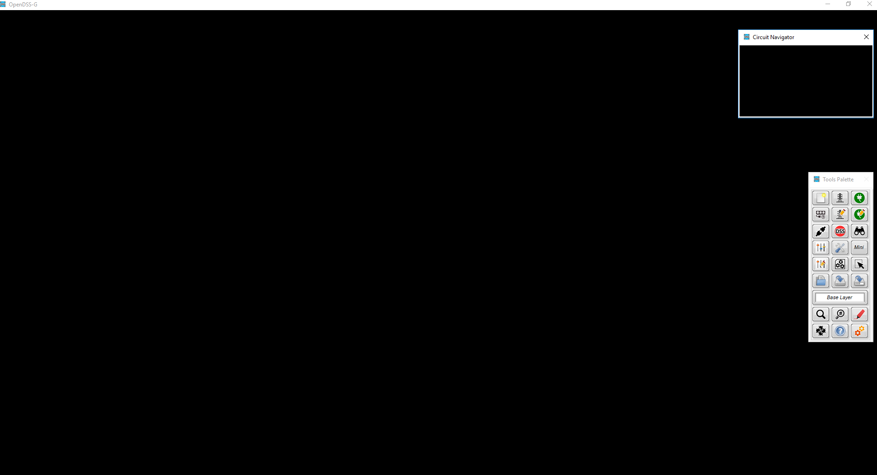
Introduction to OpenDSS-G
The workspace
3
1
2

Slide 10
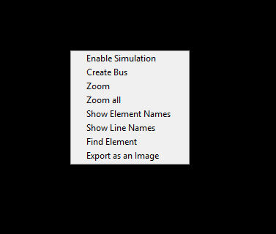
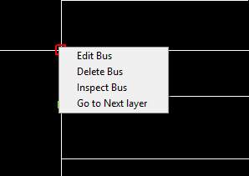
Introduction to OpenDSS-G
The workspace

Slide 11
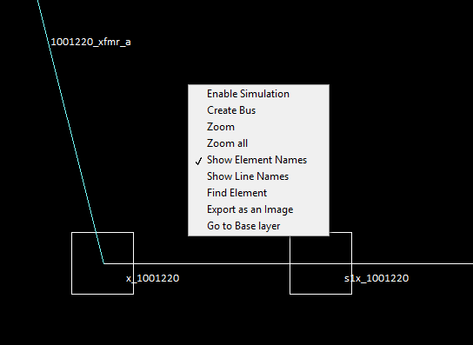
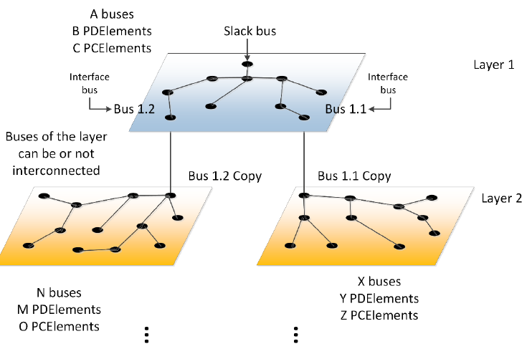
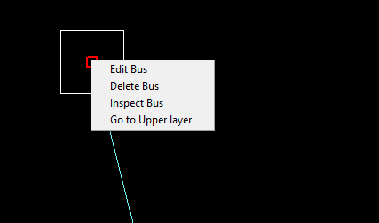
Introduction to OpenDSS-G
The workspace

Slide 12
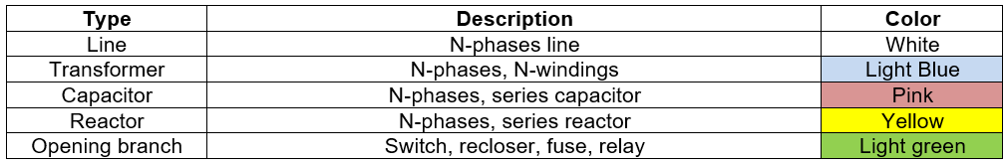
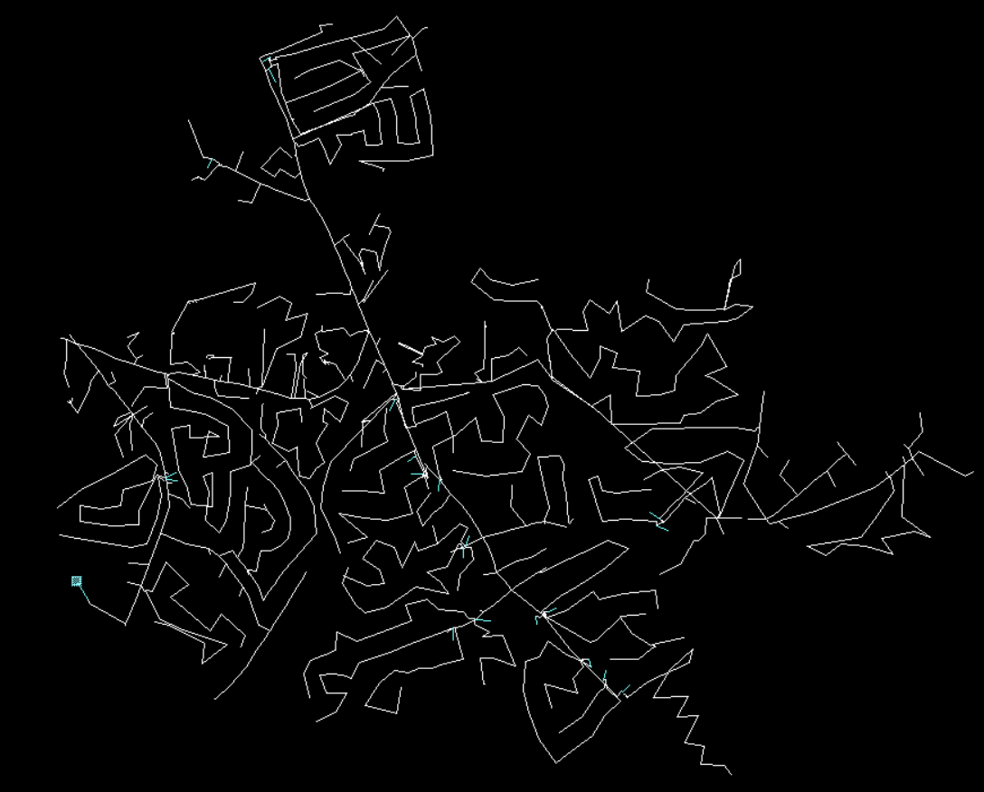
Introduction to OpenDSS-G
The workspace

Slide 13
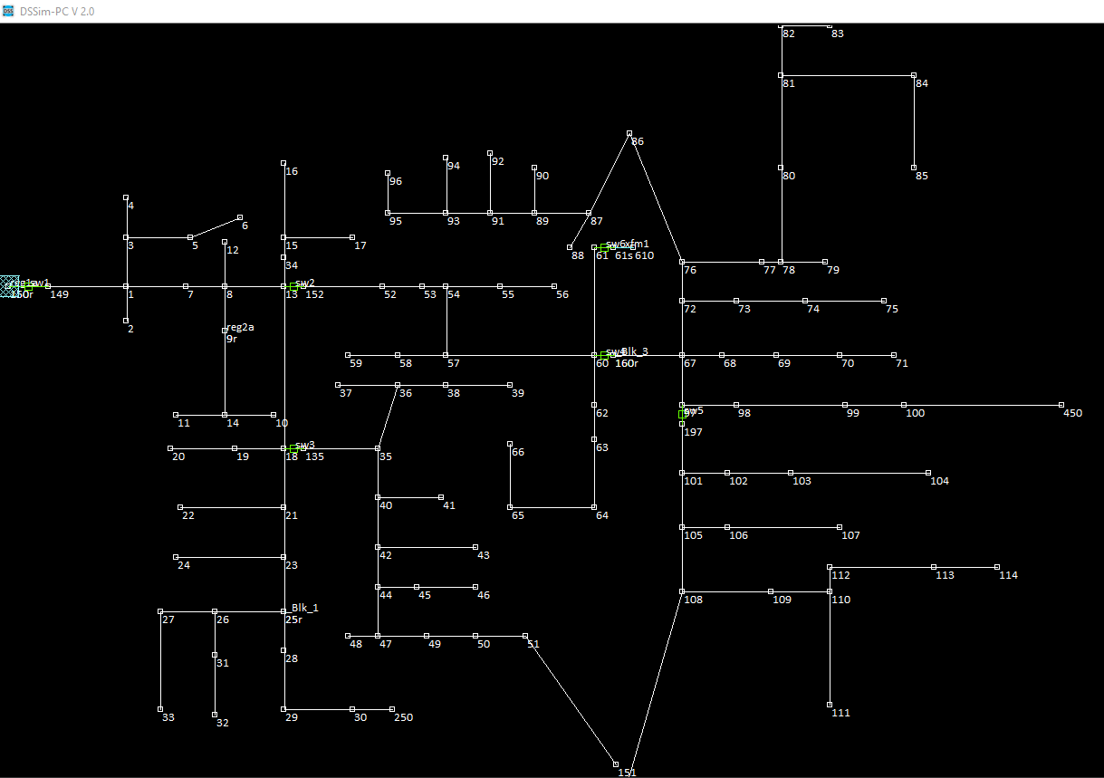
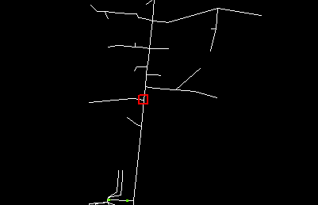
Introduction to OpenDSS-G
The workspace

Slide 14
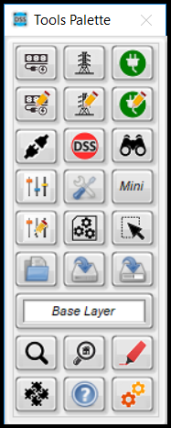
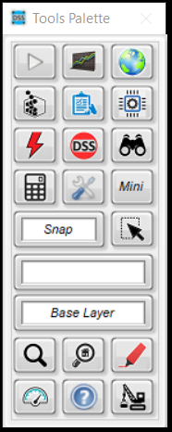
Introduction to OpenDSS-G
The Tools palette

Slide 15
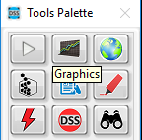

Introduction to OpenDSS-G
The Tools palette

Slide 16
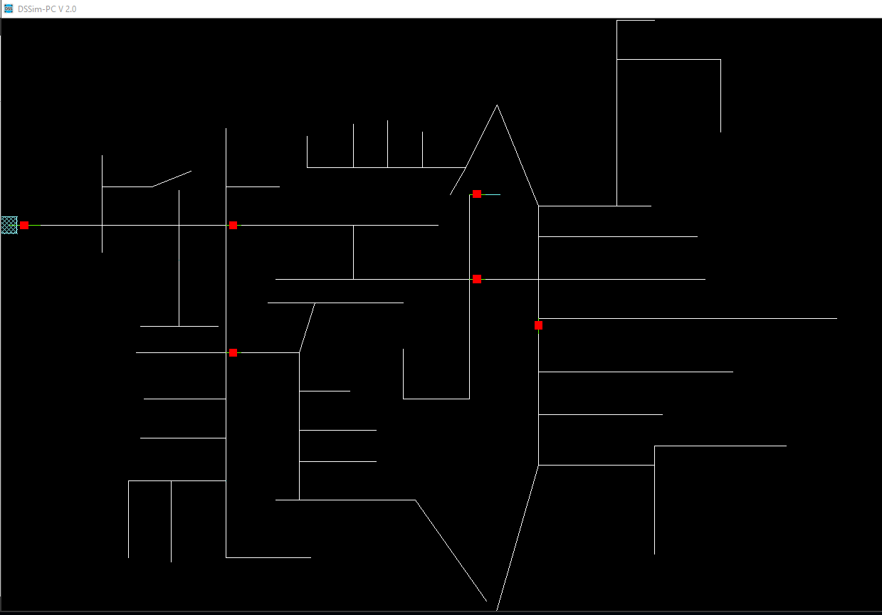
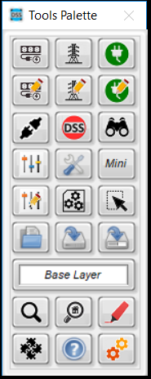
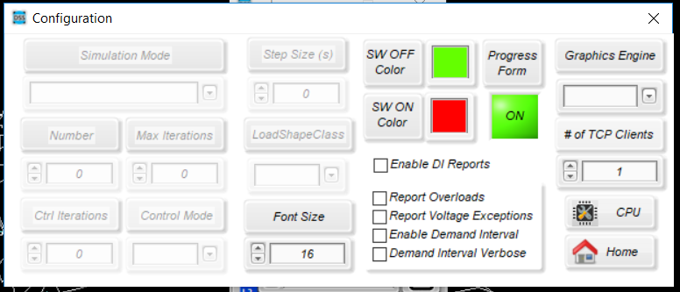
Introduction to OpenDSS-G
Configuring the environment

Slide 17
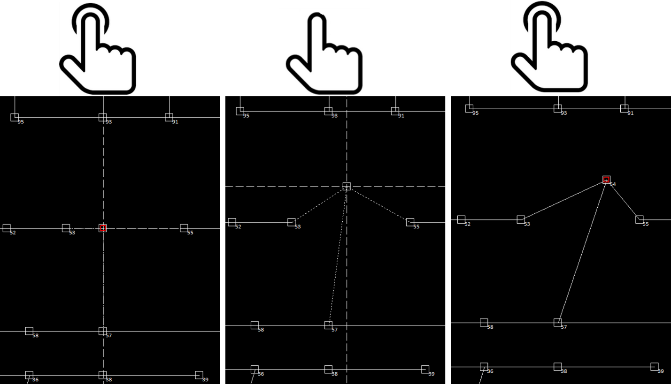
Introduction to OpenDSS-G
Editing tools

Slide 18
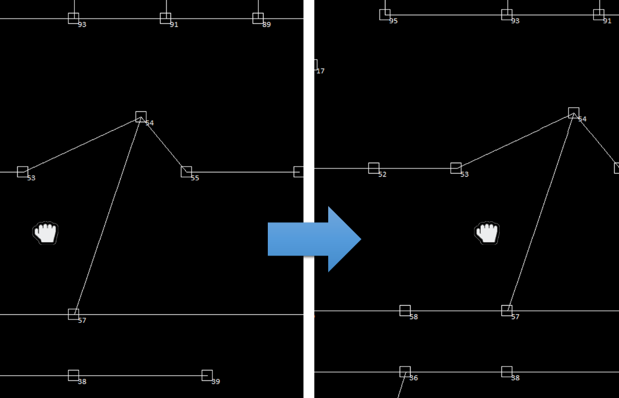
Introduction to OpenDSS-G
Editing tools

Slide 19
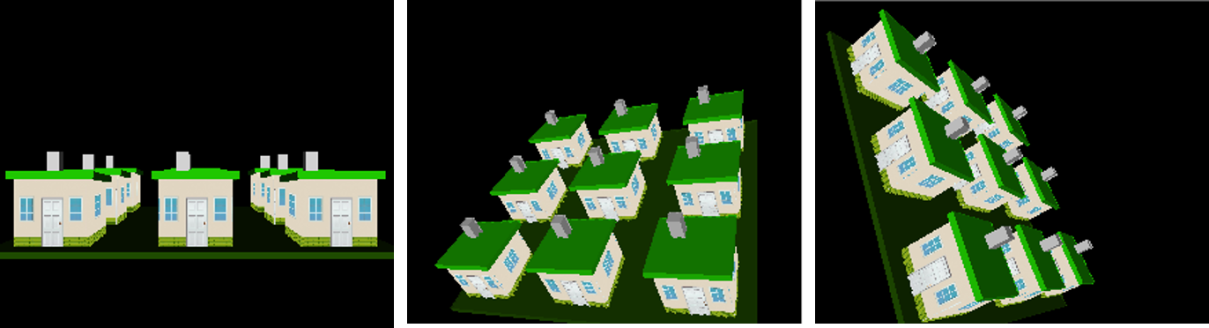
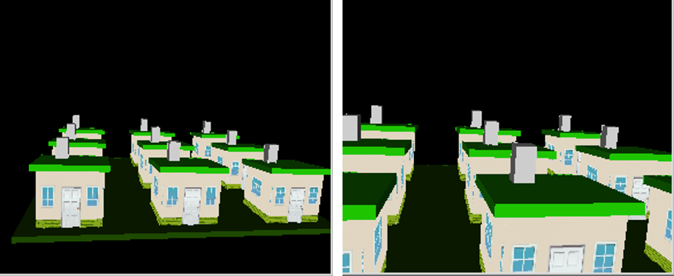
Introduction to OpenDSS-G
Editing tools

Slide 20
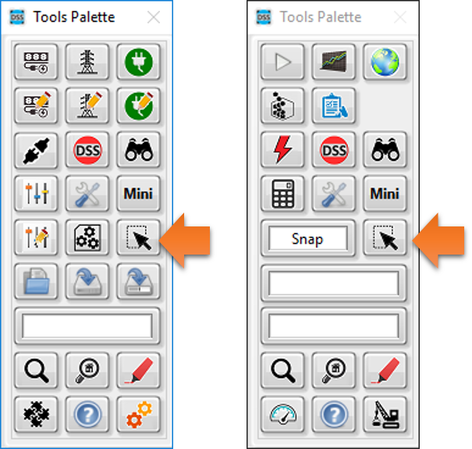
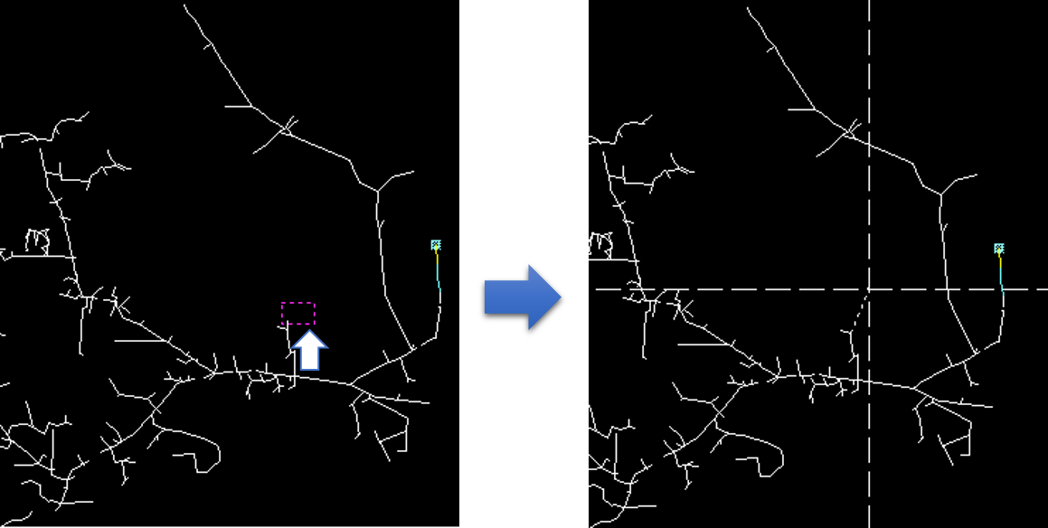
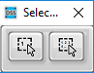
Introduction to OpenDSS-G
Editing tools

Slide 21
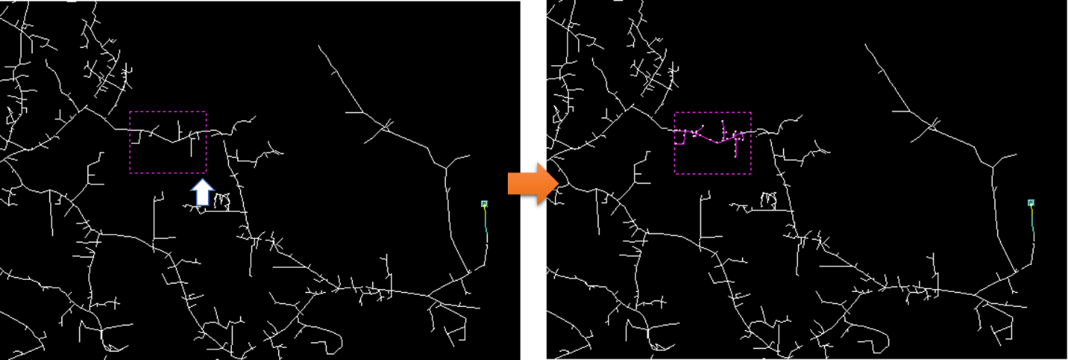
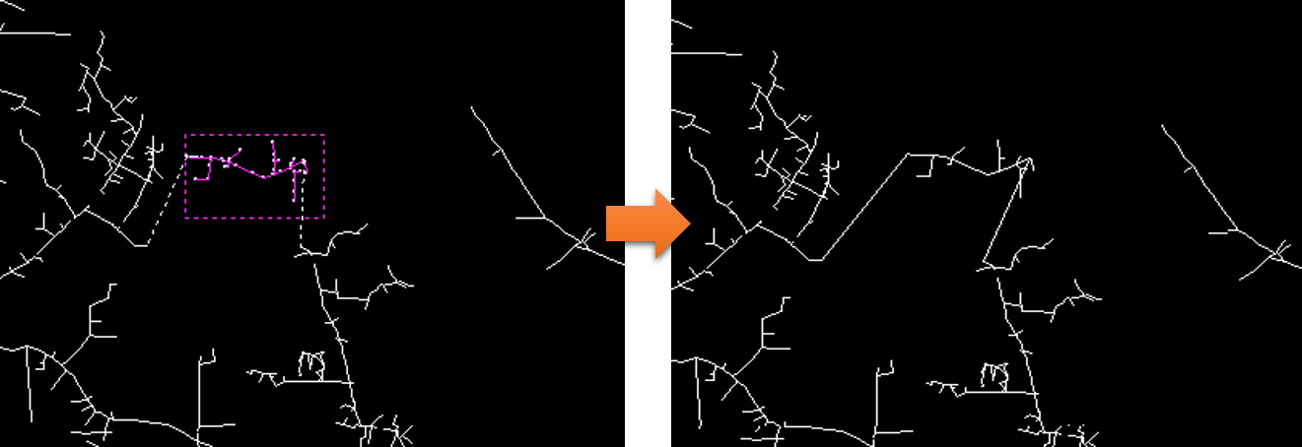
Introduction to OpenDSS-G
Editing tools

Slide 22
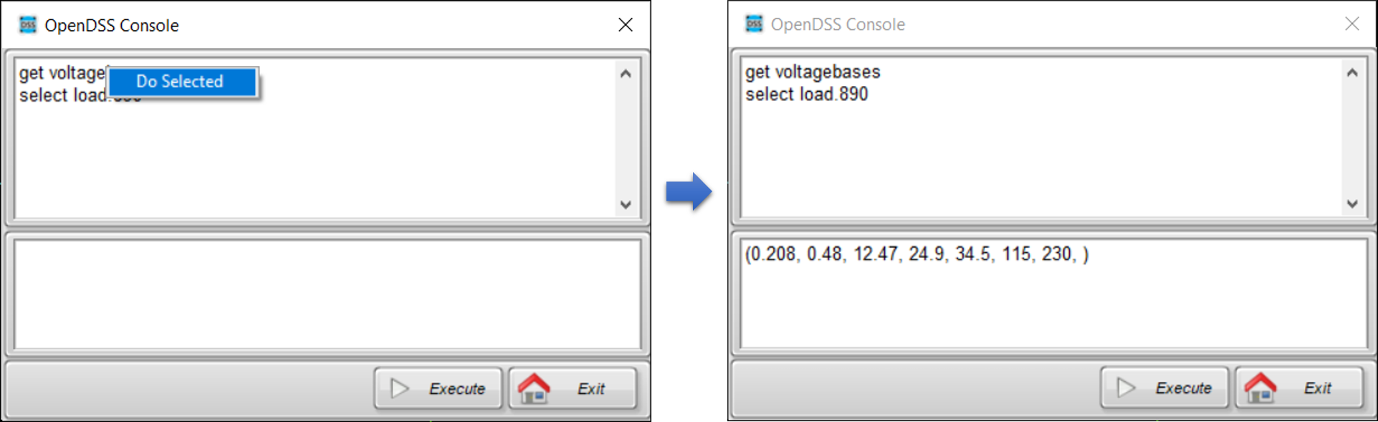
Introduction to OpenDSS-G
Editing tools

Slide 23
Creating a model

Slide 24
Model creation
There are a couple of options
Importing an existing model
Describing your circuit from the scratch

Slide 25
Model creation
Before anything
Download the examples to be used in this session:
https://sourceforge.net/p/dssimpc/code/HEAD/tree/trunk/Distribution/Examples/

Slide 26
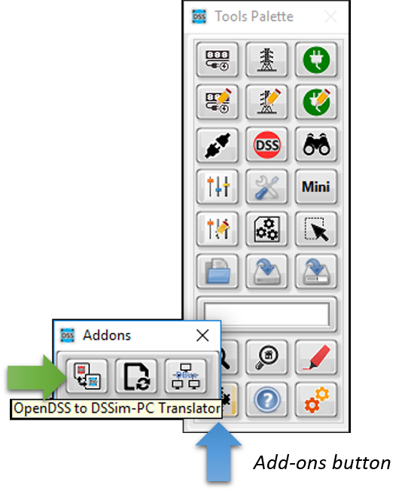
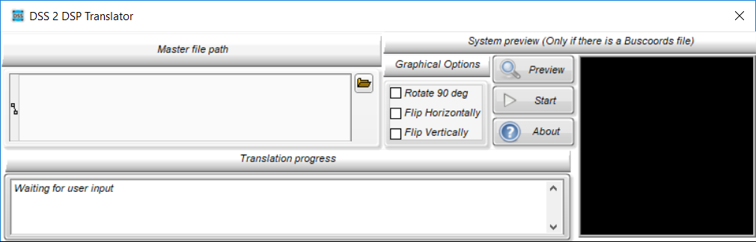
Model creation
Importing a model

Slide 27
Model creation
Importing a model
Let’s import an OpenDSS circuit

Slide 28
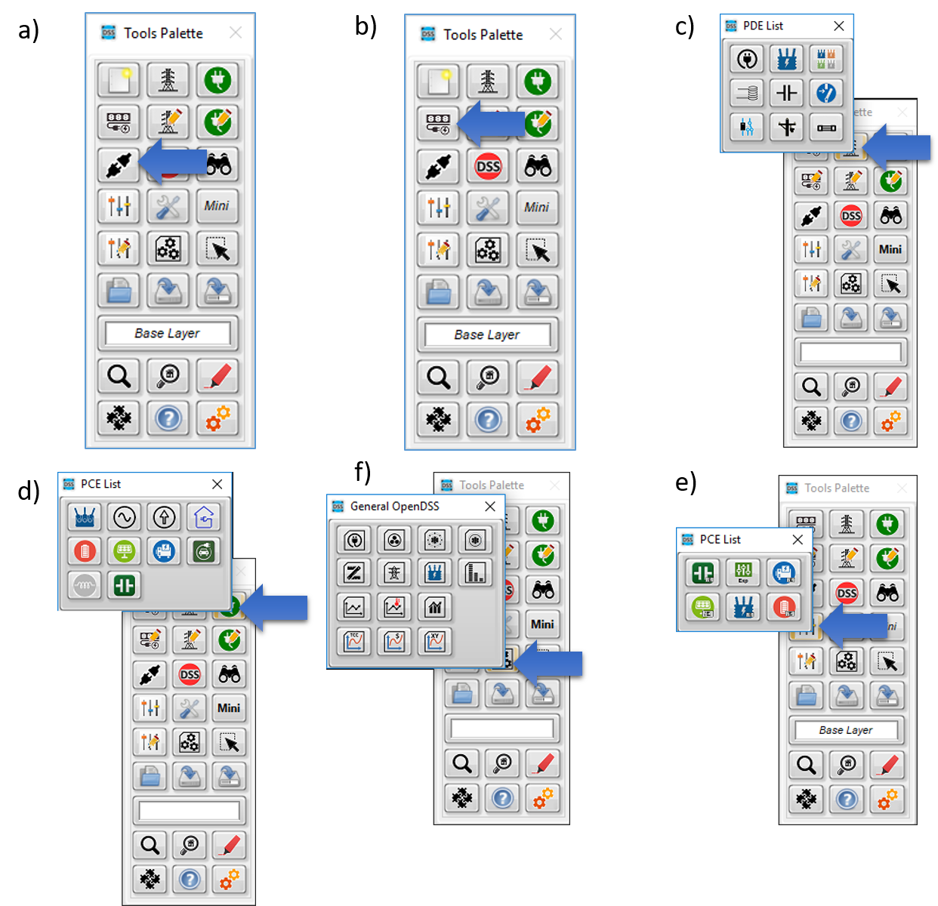
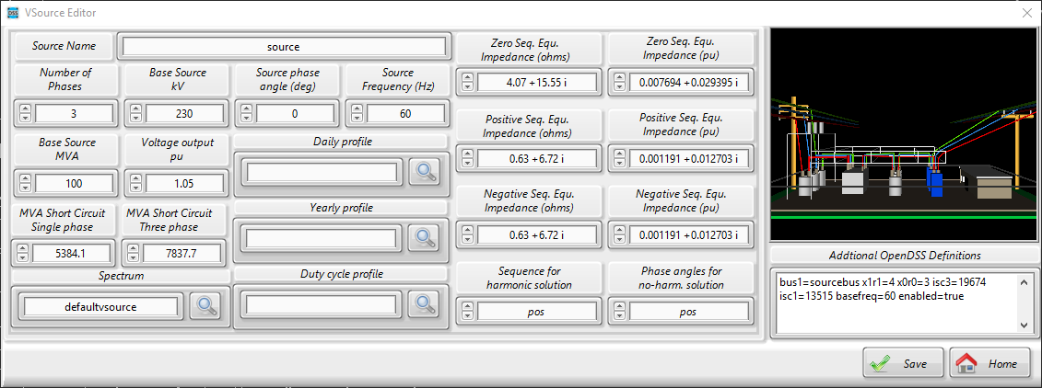
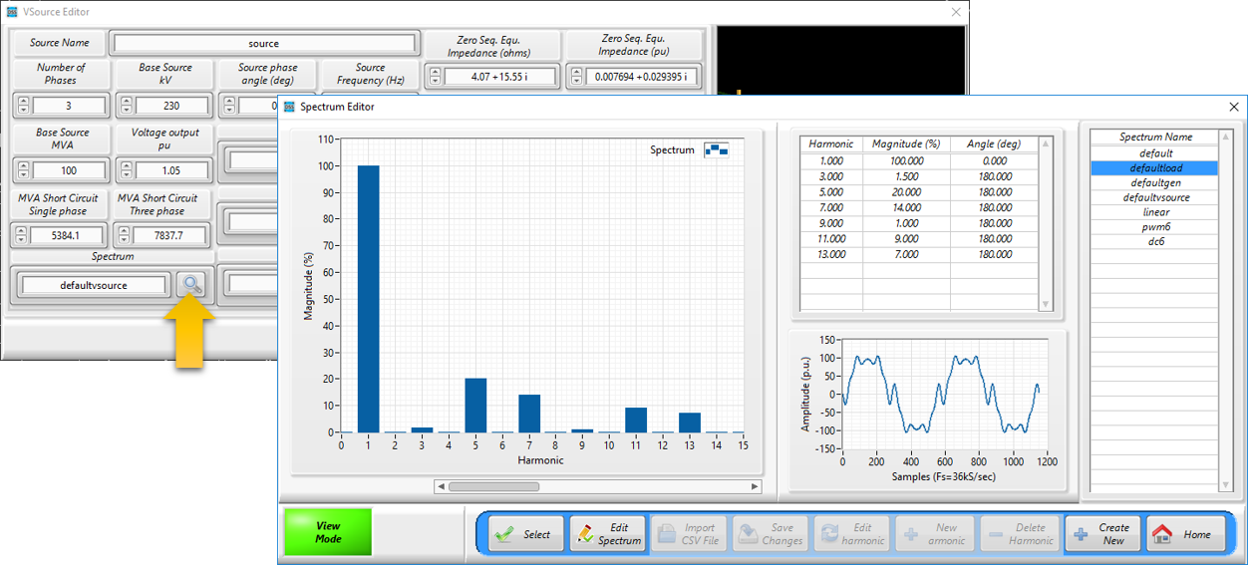
Model creation
Building the model from the scratch

Slide 29
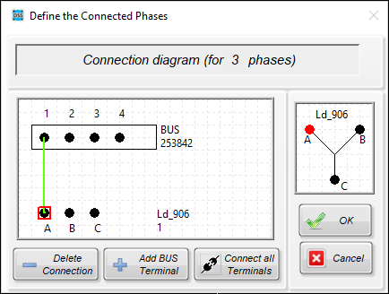
Model creation
Building the model from the scratch
Rules:
Connect your PD/PCElement to an existing bus
Follow the instructions

Slide 30
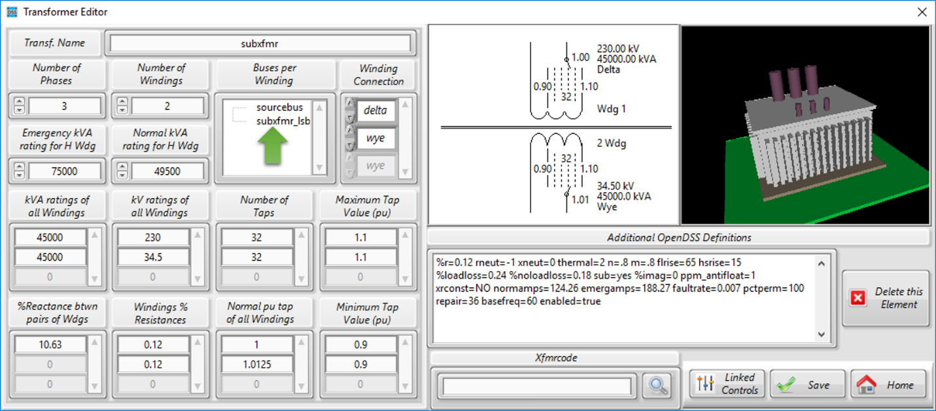
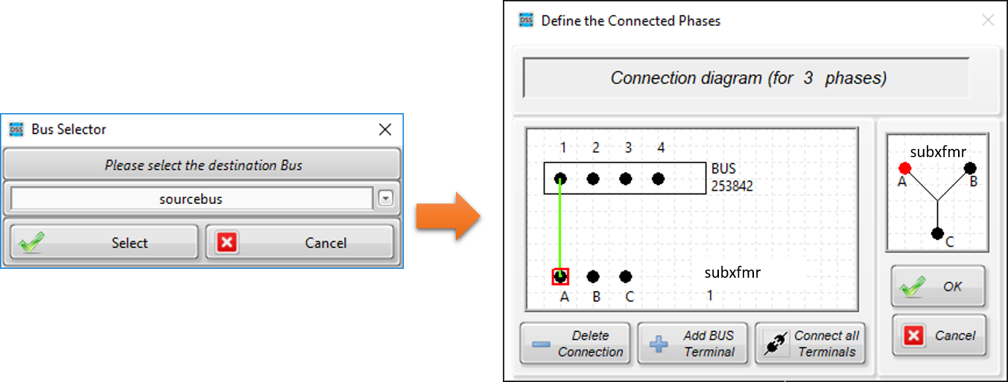
Model creation
Building the model from the scratch
(Special elements)

Slide 31
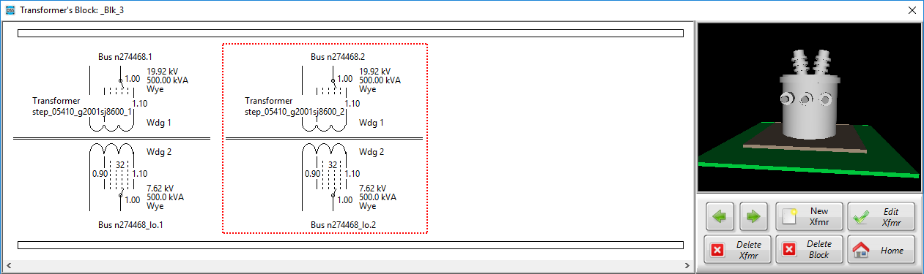
Model creation
Building the model from the scratch
(Special elements)

Slide 32
Model creation
Building the model from the scratch
Let’s build a simple circuit

Slide 33
Parallel processing using OpenDSS-G

Slide 34
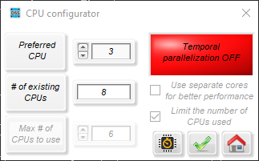
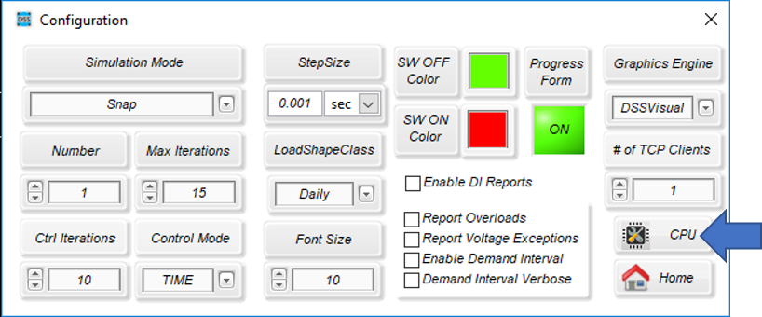
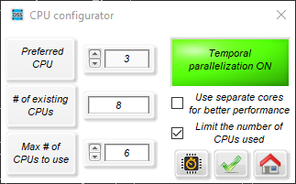
Parallel processing using OpenDSS-G
OpenDSS-G includes parallel processing capabilities that can be used through the Configuration menu.

Slide 35
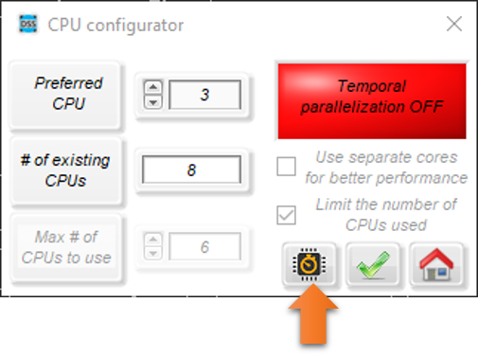
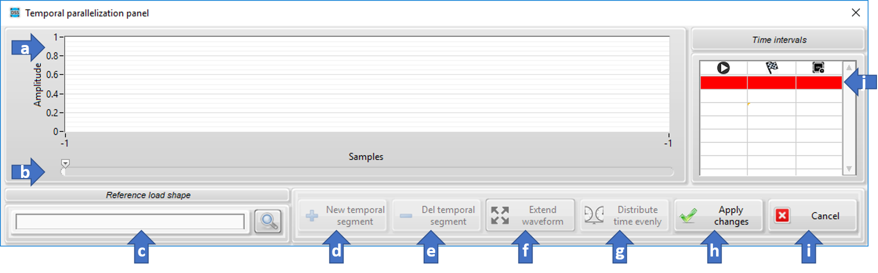
Parallel processing using OpenDSS-G
OpenDSS-G includes parallel processing capabilities that can be used through the Configuration menu.

Slide 36
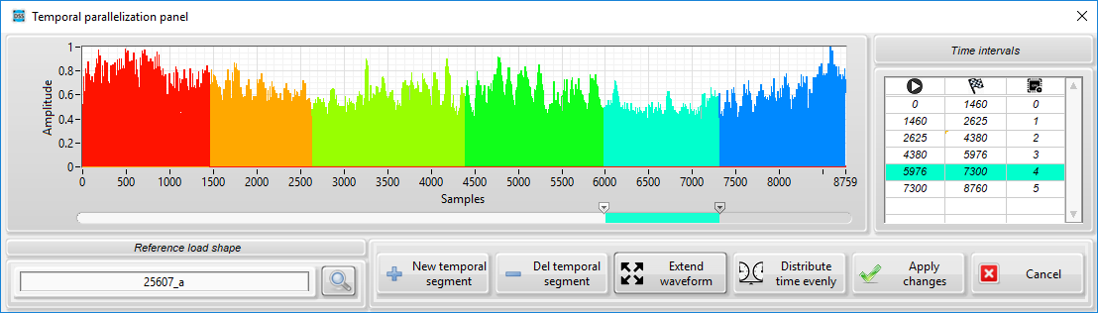
Parallel processing using OpenDSS-G
OpenDSS-G includes parallel processing capabilities that can be used through the Configuration menu.

Slide 37
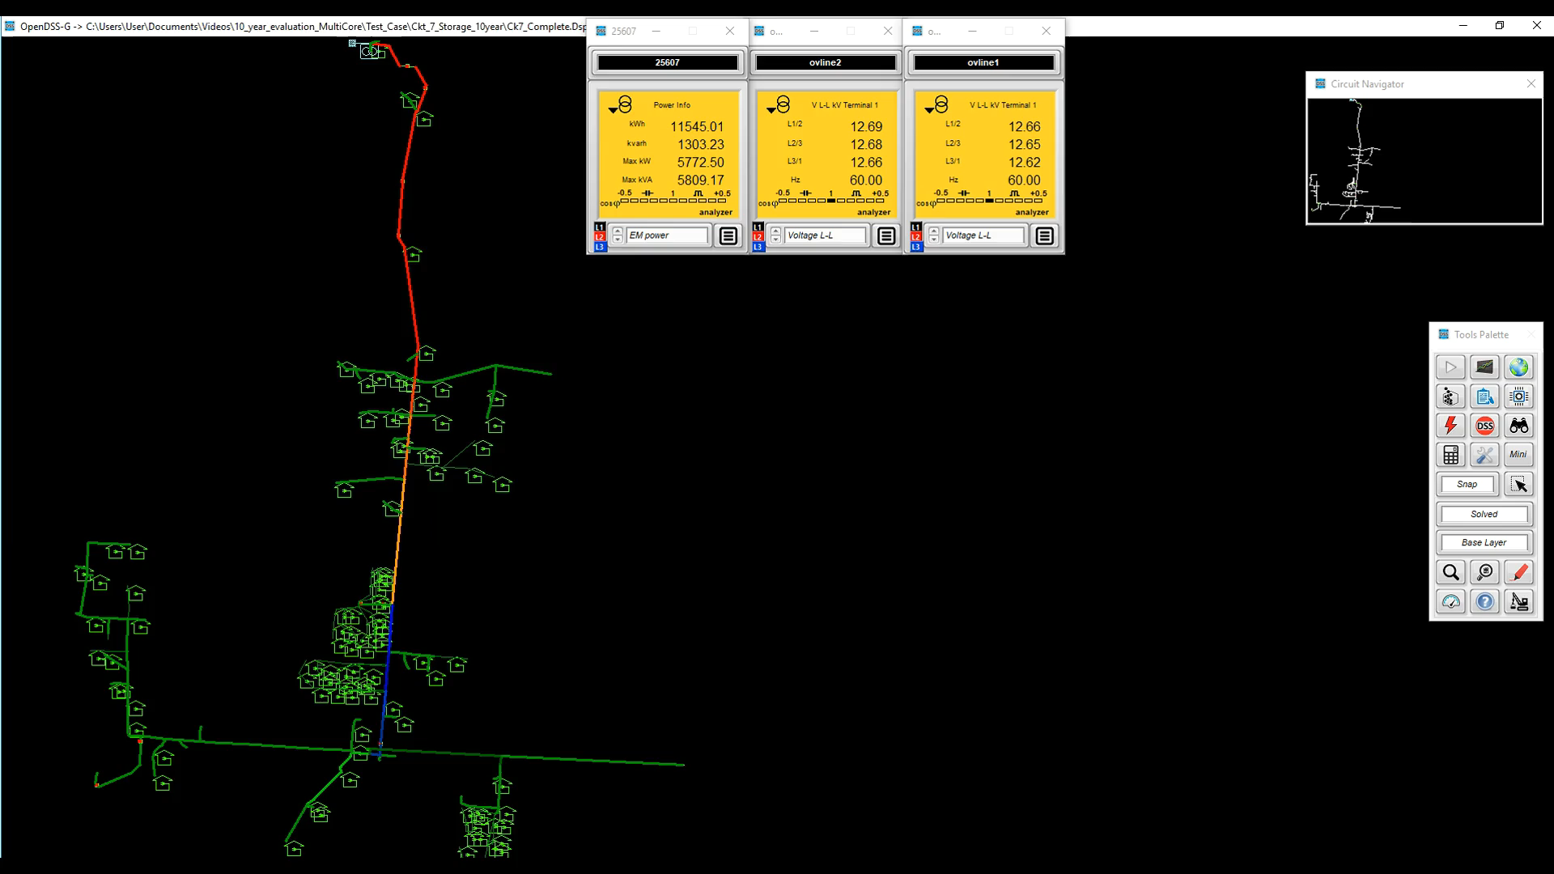
Parallel processing using OpenDSS-G
OpenDSS-G includes parallel processing capabilities that can be used through the Configuration menu.

Slide 38
Visualizing data

Slide 39
Monitors and meters in OpenDSS-G

Slide 40


Monitors and meters in OpenDSS-G
Monitors

Slide 41

Monitors and meters in OpenDSS-G
Monitors

Slide 42

Monitors and meters in OpenDSS-G
Monitors

Slide 43



Monitors and meters in OpenDSS-G
Energy meters

Slide 44

Monitors and meters in OpenDSS-G
Special mode (Harmonics)

Slide 45
Monitors and meters in OpenDSS-G
Let’s run an example

Slide 46

Model statistics
Getting information about the model

Slide 47


Finding elements within the model
Getting information about the elements within model

Slide 48


Interacting with the model
Close/open switching elements

Slide 49


Interacting with the model
Adding faults

Slide 50

Interacting with the model
Adding faults

Slide 51

Real-Time simulation
Real-Time simulation module

Slide 52

Real-Time simulation
FLISR (Fault Location, Isolation and Service Restoration) simulation module

Slide 53


Real-Time simulation
FLISR (Fault Location, Isolation and Service Restoration) simulation module

Slide 54


Visualizing elements within the model
The elements palette

Slide 55
Co-Simulating with OpenDSS-G
The TCP-IP server
OpenDSS-G has a TCP/IP server integrated for co-simulation with other platforms. The document that describes the protocol and uses can be downloaded from https://sourceforge.net/projects/dssimpc/files/Documents/DSTCP-Comm.pdf/download.
Co-simulation examples for MATLAB and NI LabVIEW can be found at https://sourceforge.net/p/dssimpc/code/HEAD/tree/trunk/Distribution/Examples/.

Slide 56
Co-Simulation with OpenDSS-G
Let’s run an example

Slide 57
Visual aids for editing in OpenDSS-G

Slide 58


Visual aids for editing in OpenDSS-G
The inspector window

Slide 59


Visual aids for editing in OpenDSS-G
The inspector window

Slide 60

Visual aids for editing in OpenDSS-G
The inspector window

Slide 61

Visual aids for editing in OpenDSS-G
Flags

Slide 62


Visual aids for editing in OpenDSS-G
Flags

Slide 63

Visual aids for editing in OpenDSS-G
The simulation explorer

Slide 64

Visual aids for editing in OpenDSS-G
The simulation explorer

Slide 65

Visual aids for editing in OpenDSS-G
The simulation explorer

Slide 66


Visual aids for editing in OpenDSS-G
The simulation explorer

Slide 67

Visual aids for editing in OpenDSS-G
The simulation explorer

Slide 68
Visual aids for editing in OpenDSS-G
Let’s run an example

Slide 69

Visual aids for editing in OpenDSS-G
Other graphics

Slide 70


Visual aids for editing in OpenDSS-G
Other graphics

Slide 71

Visual aids for editing in OpenDSS-G
Other graphics

Slide 72


Visual aids for editing in OpenDSS-G
Quick measurements

Slide 73

Visual aids for editing in OpenDSS-G
Quick measurements

Slide 74

Visual aids for editing in OpenDSS-G
Quick measurements

Slide 75
Visual aids for editing in OpenDSS-G
Let’s run an example

